Slide 1
Lecture 5 Happiness and Prosperity – Current Scenario

Slide 2
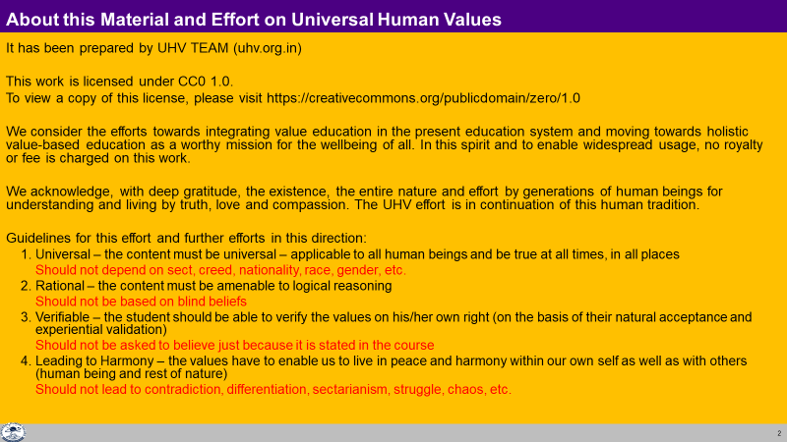

Slide 3
Continuous Happiness – Basic Aspiration of every Human Being
Every human being aspires for continuous happiness
The program for it depends on whatever s/he has understood or assumed about it
e.g. big house, lots of money… tasty food, loud music, fast car… attention, name, fame…
Keeps shifting from one program to another when the program is not successful
e.g. not getting attention of spouse… shift to watching TV… add tasty food… smoking, drinking... Indulgence… renunciation…

Slide 4
Some Prevailing Notions related to Happiness
I will be bored of happiness if I am always happy
I will grow only if I am unhappy. If I become happy, my growth will stop
I need to be unhappy to recognize that I am happy
We think of others only when we are unhappy. Thus it is important/useful to be unhappy so that one can help others
Happiness and unhappiness go together, they cannot be separated
Yes, I want happiness. But my desiring does not guarantee it. So, why to talk of desire?
My happiness depends on the others. What can I do about it
We do not want happiness for ourselves – but we want to make others happy (while we stay unhappy)
Happiness is a small thing. We have higher aspirations – like contentment, peace, bliss etc.
Do not bother me with happiness. I have to live and deal with things in my real life.

Slide 5
Some Prevailing Notions of Happiness – Excitement not Happiness
Owning / accumulating physical facility
Physical facility is required, but it alone does not suffice for human being
Dependence on physical facility, can’t be continuous
Pleasure (from favourable sensation)
Sound, Touch, Form, Taste, Smell – Through the Body
Tasty-Necessary → Tasty-Unnecessary → Tasteless-Unnecessary → Intolerable
Dependence on sensation, can’t be continuous
Attention, appreciation… (favourable feelings) from others
Dependence on the other, can’t be continuous
Sometimes “happiness”, excitement…
Sometimes “unhappiness”, depression…

Slide 6
Some Prevailing Notions about Escaping from Unhappiness, Depression
Over eating
Over sleeping
…
Gutka (Doma)
Alcohol
Drugs
…
Violence
…
Suicide

Slide 7
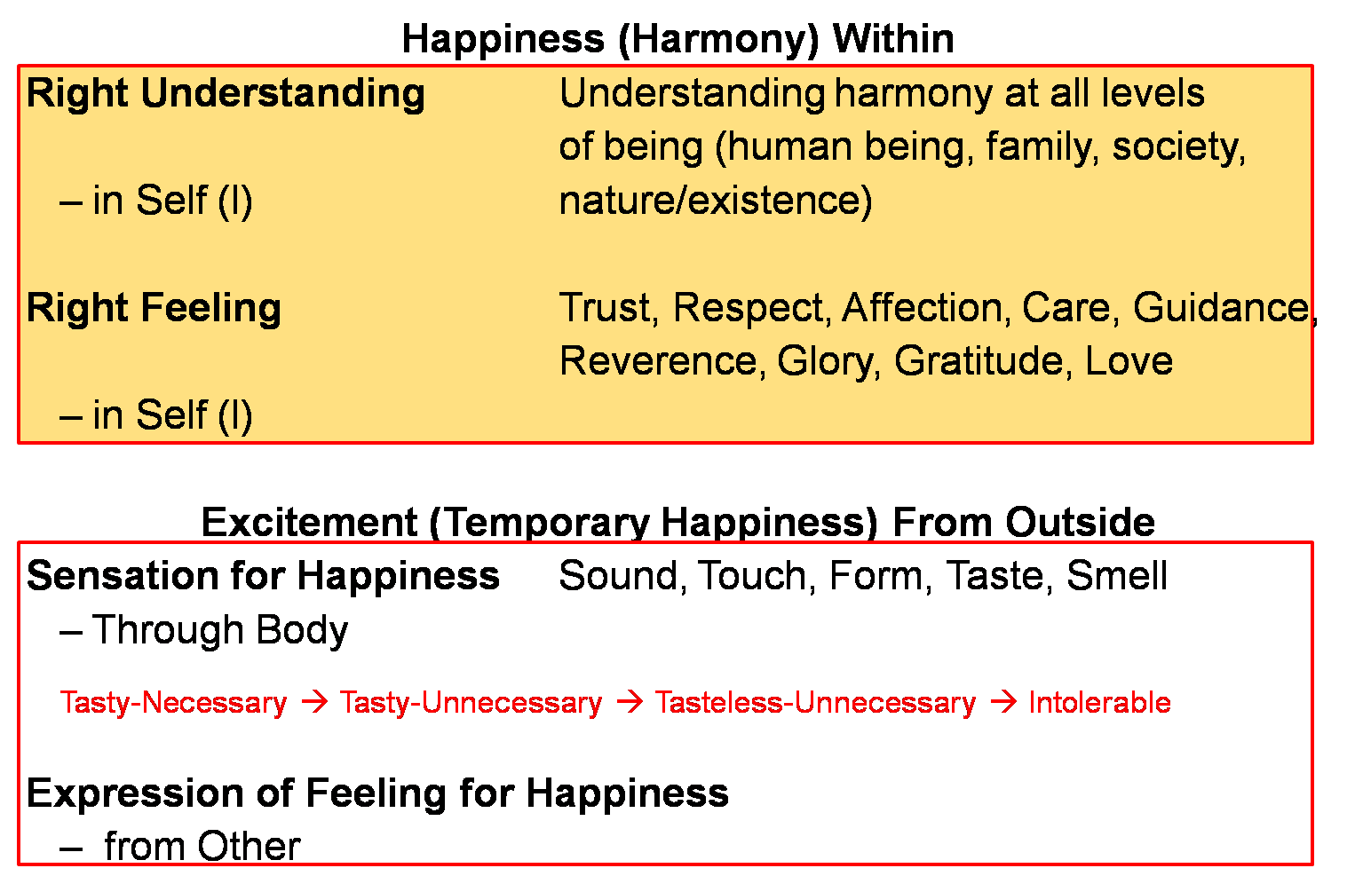
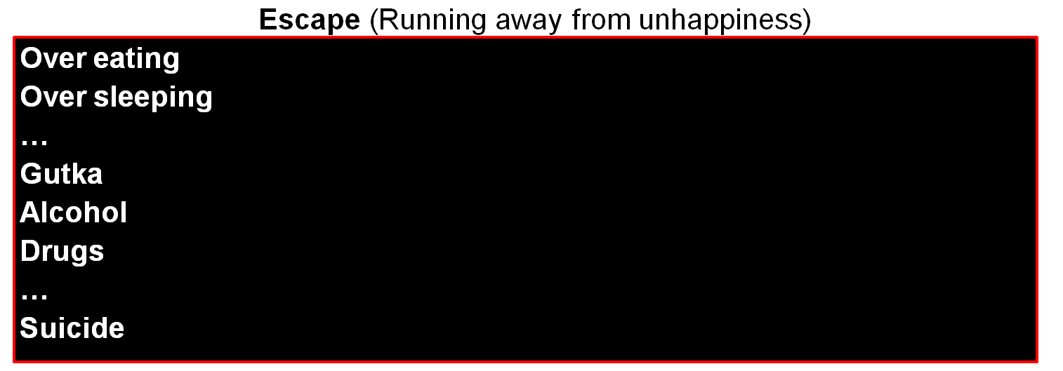
Excitement and Escape – Not Happiness
Temporary excitement
Recovering
Addict
Animal Consciousness
Temporary escape from unhappiness
Addict

Slide 8
Continuous happiness
Realised
(Dorji)
Human Consciousness
--------------------------------------------------------------------- Transformation / Development -----------------------------------------
Temporary excitement
Recovering
Addict
Animal Consciousness
Temporary escape from unhappiness
Addict

Slide 9
Sources of Happiness
Right Understanding
Harmony at all levels of being
Human Being, Family, Society, Nature/Existence
– Ensured in Self (I) Continuous, No dependence on the outside Definite completion point, Self-organization (Swatantrata)
2. Right Feeling Trust, Respect, Affection, Care, Guidance,
Reverence, Glory, Gratitude, Love
– Ensured in Self (I) Continuous, No dependence on the outside, Definite completion point, Self-organization (Swatantrata)
– From Other Temporary, Dependence on Other (Partantra)
Indefinite, No completion point
3. Sensation Sound, Touch, Form, Taste, Smell
– Through Body Temporary, Dependence on Body & Other (Partantra)
Indefinite, No completion point
Physical Facility: Tasty-Necessary → Tasty-Unnecessary → Tasteless-Unnecessary → Intolerable

Slide 10
Some Prevailing Notions related to Prosperity
Accumulation of Wealth = Prosperity?
The richer you are, the more prosperous you are, i.e. the more you have accumulated, the more prosperous you are.

Slide 11
Key Points
Happiness and Prosperity – Current Scenario

Slide 12
Sources of Happiness
Right Understanding
Harmony at all levels of being
Human Being, Family, Society, Nature/Existence
– Ensured in Self (I) Continuous, No dependence on the outside Definite completion point, Self-organization (Swatantrata)
2. Right Feeling Trust, Respect, Affection, Care, Guidance,
Reverence, Glory, Gratitude, Love
– Ensured in Self (I) Continuous, No dependence on the outside, Definite completion point, Self-organization (Swatantrata)
– From Other Temporary, Dependence on Other (Partantra)
Indefinite, No completion point
3. Sensation Sound, Touch, Form, Taste, Smell
– Through Body Temporary, Dependence on Body & Other (Partantra)
Indefinite, No completion point
Physical Facility: Tasty-Necessary → Tasty-Unnecessary → Tasteless-Unnecessary → Intolerable

Slide 13
Continuous happiness
Realised
(Dorji)
Human Consciousness
--------------------------------------------------------------------- Transformation / Development -----------------------------------------
Temporary excitement
Recovering
Addict
Animal Consciousness
Temporary escape from unhappiness
Addict

Slide 14
FAQs for Lecture 5
Happiness and Prosperity – Current Scenario

Slide 15
Prevailing Notions related to Happiness 1 Response
Is there any difference between excitement and happiness?
Happiness = harmony
Does not depend on the outside
Can be continued
Excitement may or may not be harmony
Depends on the outside
May not have provision of continuity
Excitement is momentary, you can not have the continuity of it. If you look at yourself when you are excited, you will find that you in in a excited condition, not in harmony within.

Slide 16
Prevailing Notions related to Happiness 2 Response
I am happy when I get favorable sensation (tasty food, nice music…). Isn’t that fine?
I feel happy getting the attention and love from my mother and also some friends. What’s the problem if I live like that?
It is fine if satisfied with temporary happiness
No problem if dependence on other is OK for you and temporary happiness is what you are looking for
If feeling in other is definite, it is possible to keep getting it from other, but if it is not definite…
Feeling within (state of independence, swatantrata) or getting from other (state of dependence), begging for feeling?

Slide 17
Prevailing Notions related to Happiness 3 Response
Are all sensation bad then? What is the role of sensation then?
Is there any role of feeling from other?
Sensation from the body is a useful source of information
about the state of body,
about the pf,
about what the other is communicating
Then I can put the sensation to right use. E.g.
Deciding what to do about health of the body
Deciding about state of a physical facility, environment & what to do with it
Evaluating the state of the other, deciding how to respond
Sensation as a source of continuous happiness is the problem

Slide 18
Prevailing Notions related to Happiness 4 Response
I will be bored of happiness if I am always happy
Happiness and unhappiness go together, they cannot be separated
I need to be unhappy to recognize that I am happy
If it is excitement, you are likely to get bored sooner or later
Check if you really get bored with harmony (like health in the body)
Yes, if excitement is assumed to be happiness, then the momentary happiness and unhappiness do go together
Check if you really desire for even a moment of unhappiness to recognize happiness
(like disrespect from time to time to recognize respect)

Slide 19
Prevailing Notions related to Happiness 5 Response
I will grow only if I am unhappy. If I become happy, my growth will stop
My happiness depends on the others
Happiness is a small thing. I have higher aspirations – like contentment, peace, bliss etc.
We have assumed all growth is to happen in the physical world
At the core, holistic development has to do with development of the consciousness – development of right understanding and right feeling
True if happiness is assumed to be on account of right feeling from other. Check if it is happiness or temporary excitement
True, particularly if happiness is assumed to be same as sensory pleasure
We are referring to continuous happiness which includes happiness, peace, satisfaction and bliss, etc.

Slide 20
Prevailing Notions related to Prosperity 1 Response
Accumulation of Wealth = Prosperity?
The richer you are, the more prosperous you are, i.e. the more you have accumulated, the more prosperous you are.
Covered in previous lecture

Slide 21
Prevailing Notions related to Prosperity 2 Response
I personally do not want so many physical facilities. But I want to make my family secure for the future, hence I have to keep working for more and more physical facilities.
There is no prosperity without wealth.
What you are saying makes sense. But I will work for it once I get to some good position in the society, have a good amount of money
People will pay attention to my words only if I prove myself to be successful by the prevailing standards in the society. Hence I have to accumulate wealth first.
This is all ‘lecture’. Ultimately what matters in the society today is money. There is no status in society without money.
Covered in previous lecture

